Slide 1
UCSD Embedded Linux Assignment 8
By
Hsuankai Chang
hsuankac@umich.edu

Slide 2
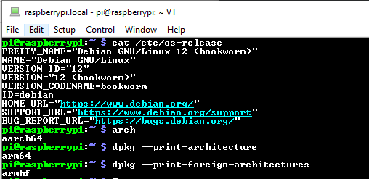
Step 1. Point of reference, brand new install

Slide 3
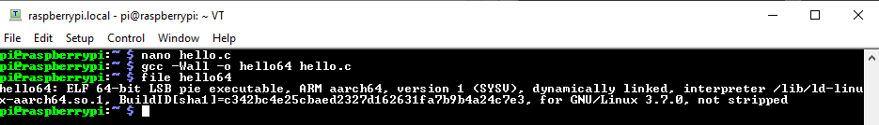
Step 2. hello.c – aarch64

Slide 4
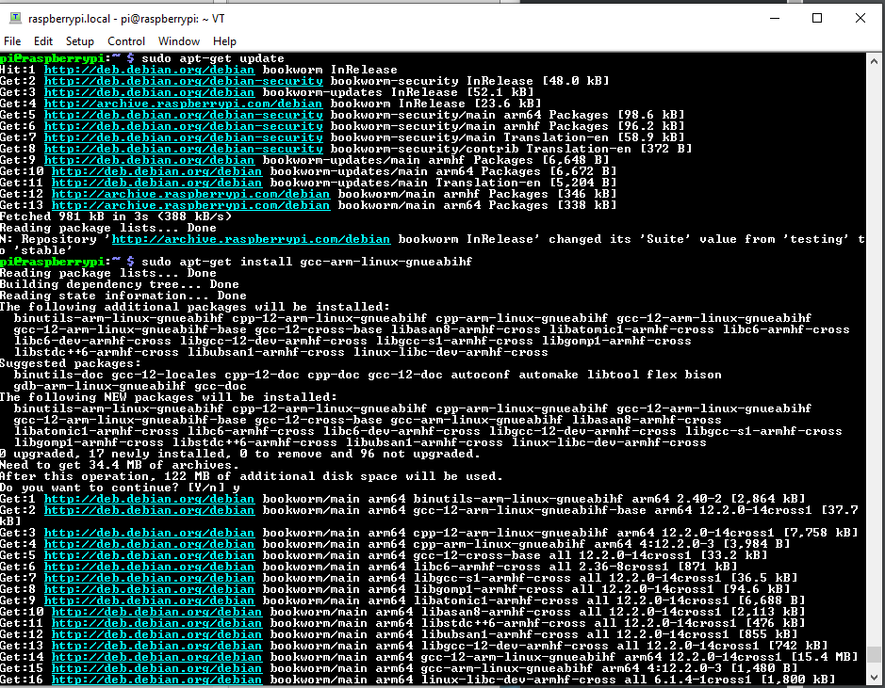
Step 3. Install cross compiler - armhf

Slide 5
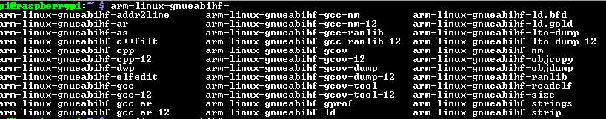
Step 4. Results – cross toolchain

Slide 6
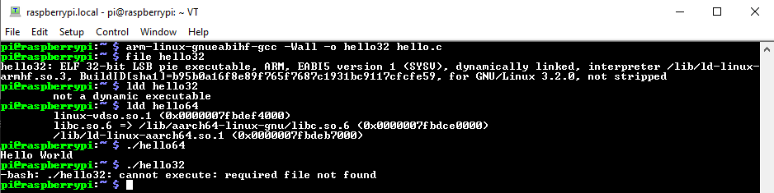
Step 5. Results

Slide 7
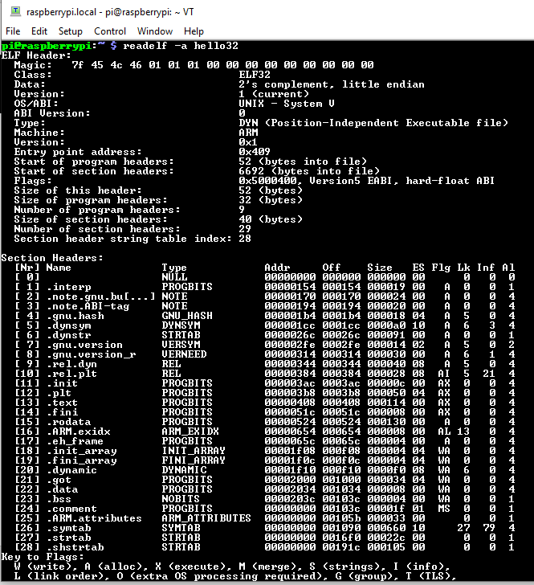
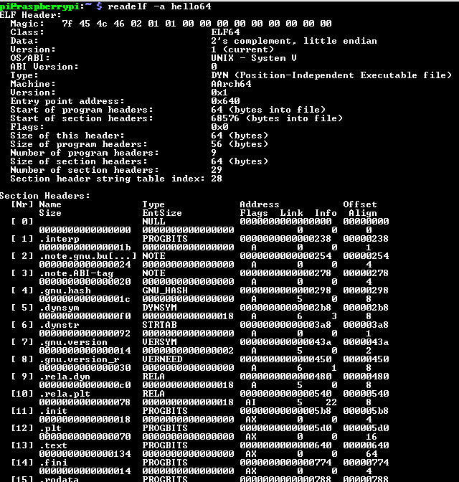
Step 6. readelf –a hello32 vs hello64

Slide 8

Step 7. readelf –a hello32 and hello64 interpret

Slide 9
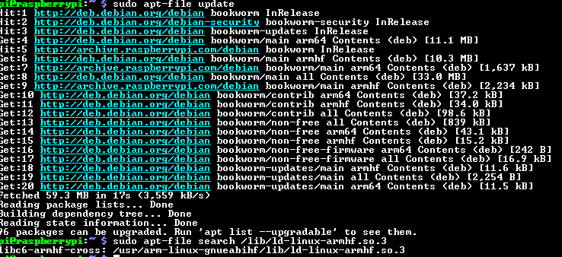
Step 8. apt-file list

Slide 10
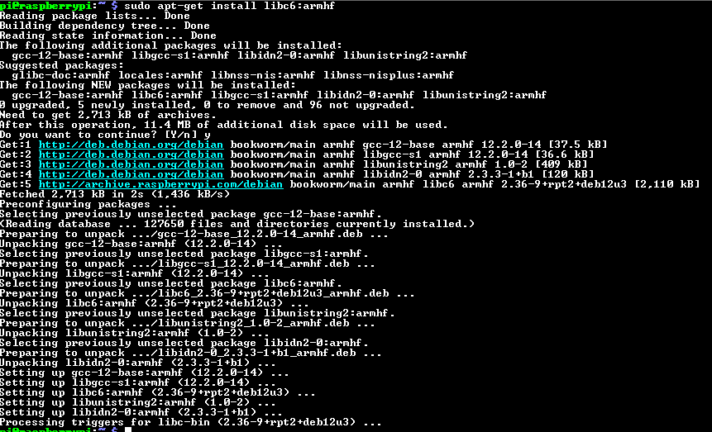
Step 9. Install libc6:armhf

Slide 11
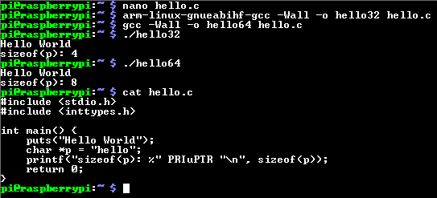
Step 10. We can run both 64 bits and 32 bits target

Slide 12
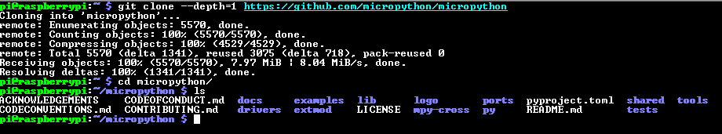
Step 11. Clone micropython

Slide 13
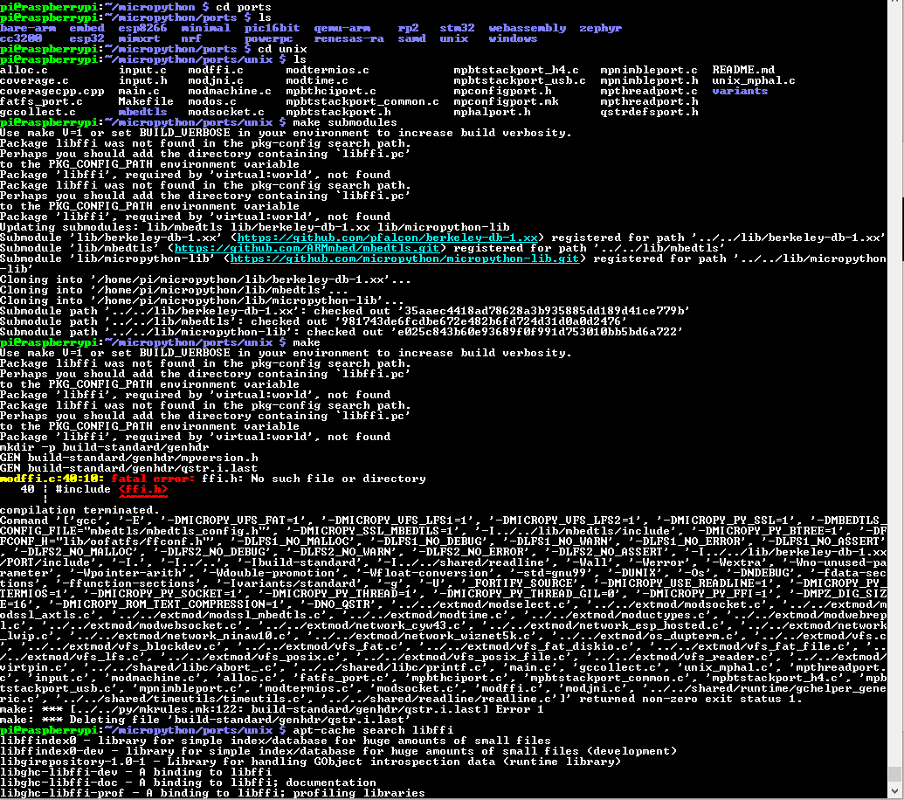
Step 12. Building micropython for linux – missing libffi

Slide 14
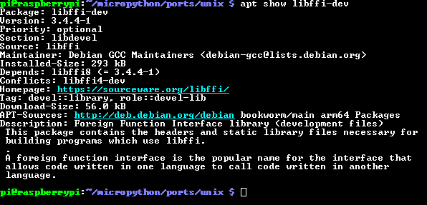
Step 13. apt show libffi-dev

Slide 15
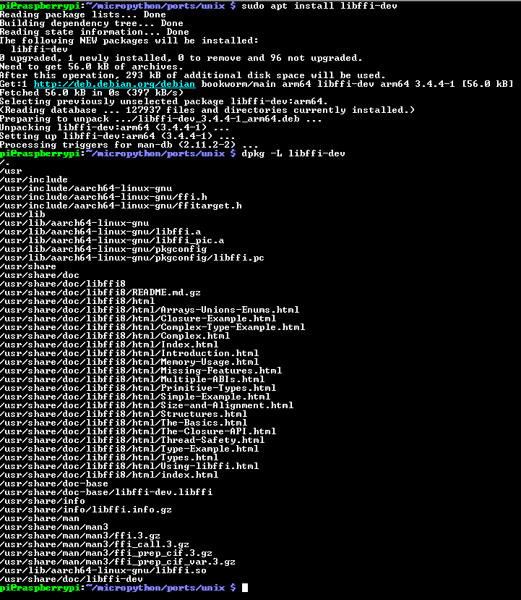
Step 14. sudo apt install libffi-dev

Slide 16
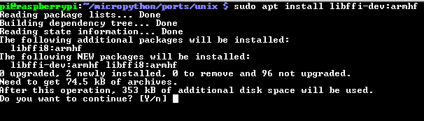
Step 15. Also install the armhf version

Slide 17
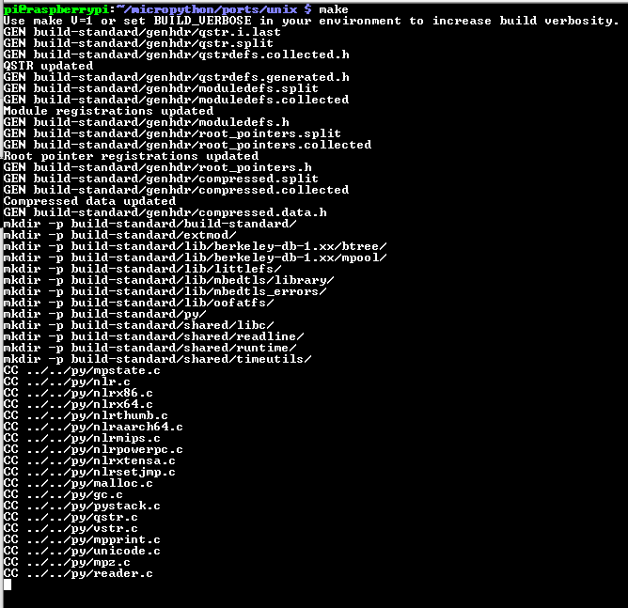

Step 16. make and try to run it

Slide 18
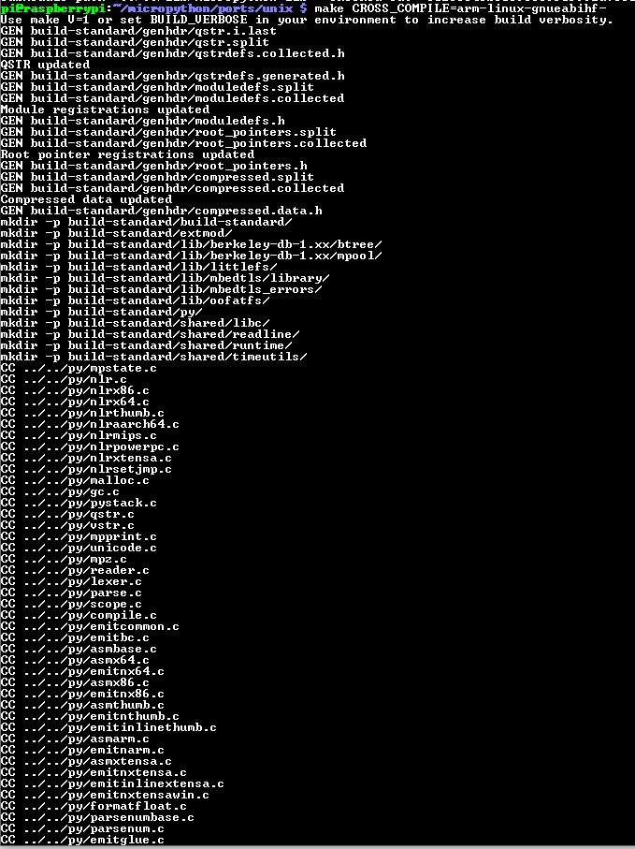
Step 17. Compile for 32 bit machine, it is successful.

Slide 19
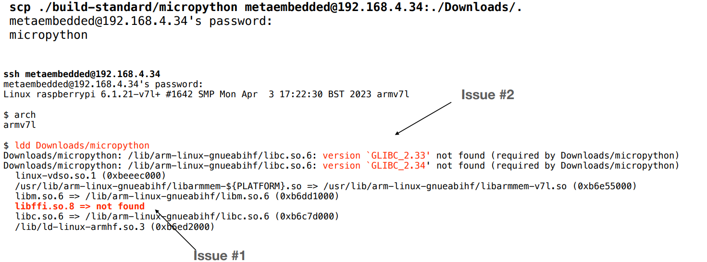
Step 18. When trying to run on 32 bit target, issues happened. Since I do not have another 32 bit target, I will just copy and paste the slides here.

Slide 20
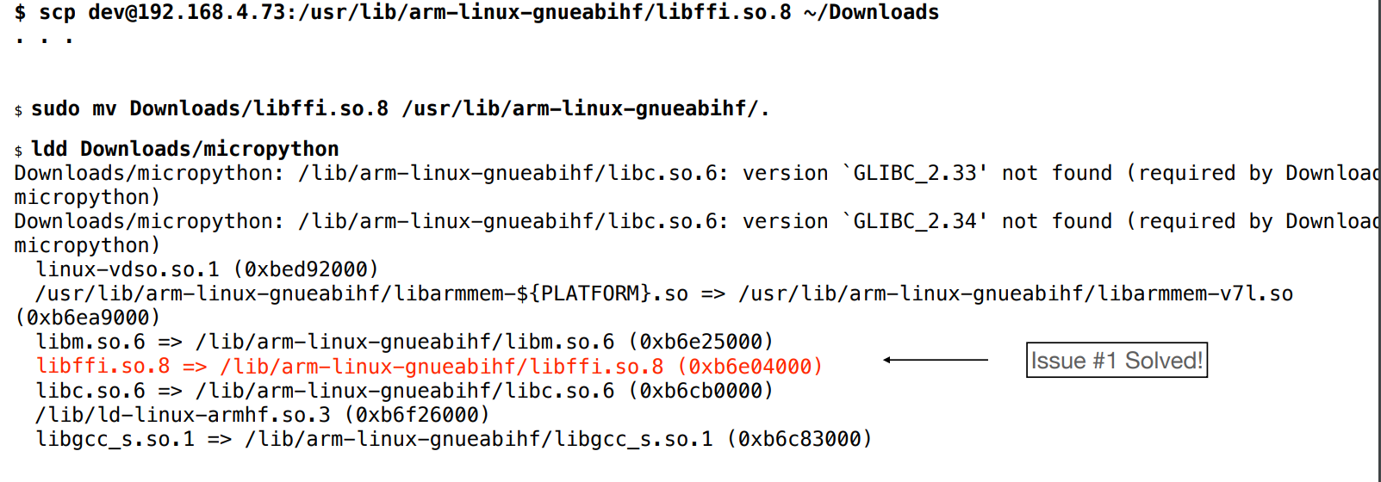
Step 19. If facing libffi.so.8 missing, simply copy this file from host to target

Slide 21
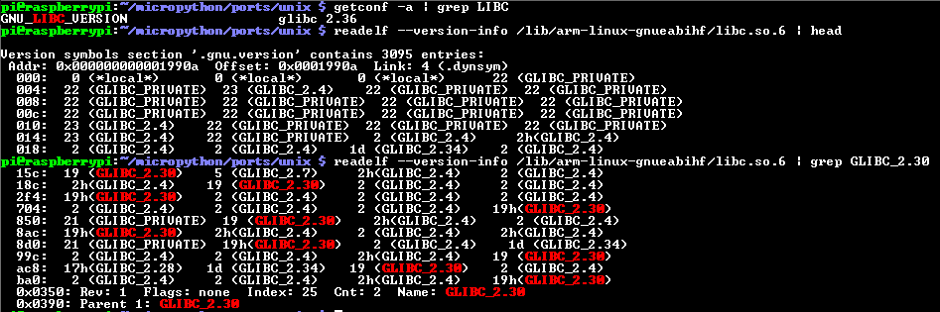
Step 20. glib has versioned symbols

Slide 22
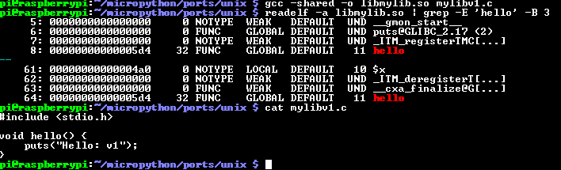
Step 21. No symbol versioning

Slide 23
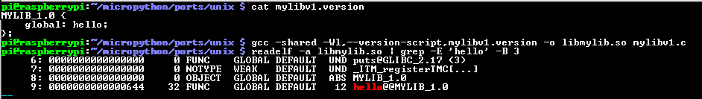
Step 22. Symbol versioning

